Slide 1
Radix Sort
Des O’ Carroll

Slide 2
Radix Sort
Not a comparison sort – i.e. Does not compare two items on a list
Takes an unsorted list as input and outputs a sorted list
It makes use of the values in the individual keys to order the items

Slide 3
Radix Sort
The Radix sort divides the values to be sorted into as many subgroups as there are possible alternatives for each position in the key
E.g if the key is an integer, each position is a digit and has ten possibilities 0...9
E.g if the key is a string (and case does not matter) then each position has 26 possibilities ‘a’ ... ‘z’
The number of possibilities is called the RADIX

Slide 4
Radix Sort
After subdividing the values into radix subgroups, we recombine them into one array, and repeat the process
If we begin with the least significant position in the key, regroup the values in order, and repeat the process as many times as there are positions in the key, moving one position to the left each time – the array will be sorted when we finish
Let’s illustrate by sorting an array of 3-digit positive integers

Slide 5
Radix Sort
Let’s view a key as being made up of one’s, tens, and hundred’s positions
e.g. 762 = 7(x100), 6(x10), 2(x1)
Let’s refer to these positions as 1, 2, and 3 respectively
Divide the values into 10 subgroups based on the digit value in position 1

Slide 6
Radix Sort
Lets create an array of queues (queues[0]...queues[9]) to hold the groups
All keys with 0 in position 1are enqueued into queues[0]
All keys with 1 in position 1are enqueued into queues[1]
...and so on

Slide 7
Radix Sort
After the first full pass through the array, collect the subgroups (i.e. the queues) in order – queue 0, 1, 2.....9
Do the same for the tens position, and then repeat for the hundreds position
After collecting the queues for the last time, the values in the array will be in order

Slide 8
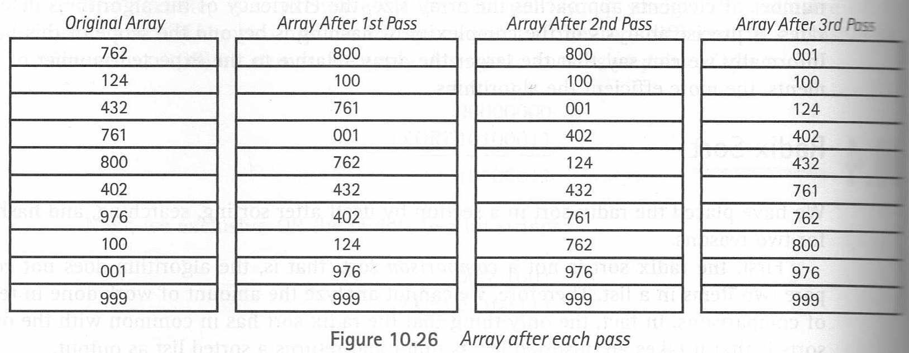
Radix Sort

Slide 9
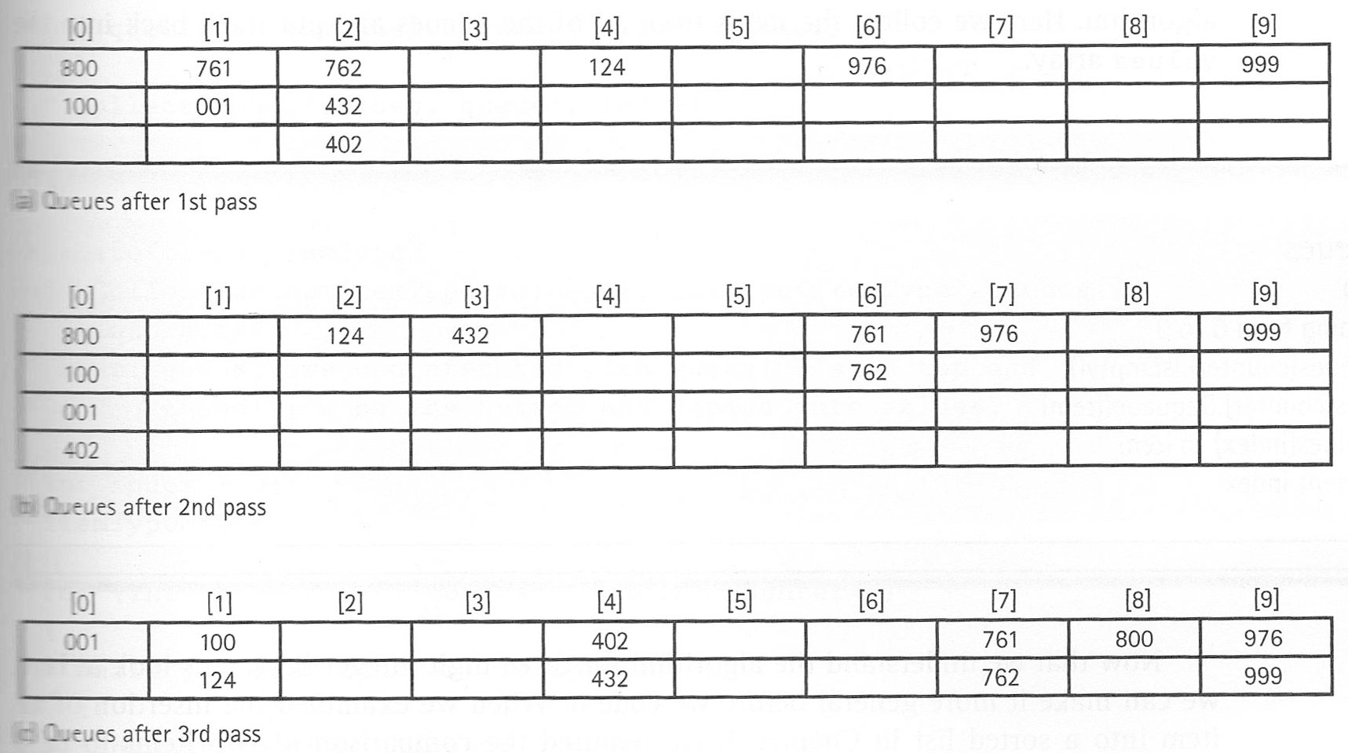
Radix Sort

Slide 10
Radix Sort
Look at the array after each pass – the digits in the position corresponding to the pass are sorted
Also, the digits in the pass number position are the same as the index of the queue that it is in

Slide 11
Radix Sort
Algorithm suitable for 3 digit integers
RadixSort(values, numValues)
for position going from 1 to 3
for counter going from 0 to numValues-1
Set whichQueue to digit at position “position” of values[counter]
queues[whichQueue].Enqueue(values[counter])
Collect queues

Slide 12
Radix Sort
Algorithm
Collect queues
Set index to 0
for counter going from 0 to 9
while not (queues[counter].isEmpty( ))
queues[counter].Dequeue(item)
Set values[index] to item
Increment index

Slide 13
Radix Sort
#include "QueType.h"
template<class ItemType>
void RadixSort(ItemType values[ ], int numValues, int numPositions, int radix)
{
QueType<int> queues[10];
int whichQueue;
for (int position = 1; position <= numPositions; position++)
{
for (int counter = 0; counter < numValues; counter++)
{
whichQueue = values[counter].SubKey(position);
queues[whichQueue].Enqueue(values[counter]);
}
CollectQueues(values, queues, radix);
}
}

Slide 14
Radix Sort
template<class ItemType>
void CollectQueues(ItemType values[ ], QueType<ItemType> queues[ ], int radix)
{
int index = 0;
ItemType item;
for (int counter = 0; counter < radix; counter++)
{
while (!queues[counter].IsEmpty( ))
{
queues[counter].Dequeue(item);
values[index] = item;
index++;
}
}
}

Slide 15
Radix Sort
If the keys are integer values, then the function SubKey( ) must take the position number and extract the digit in that position
e.g. Assume itemKey is 8749
Position is 1: itemKey%10 = 9
Position is 2: (itemKey/10) % 10 = 4
Position is 3: (itemKey/100) %10 = 7
Position is 4: (itemKey%1000)%10 = 8
Note: as the position no increases, the 2nd operand of the / operation increase

Slide 16
Radix Sort
Rewrite the first calculation to match the pattern of the others
Position is 1: (itemKey/1)%10 = 9
Generalise
Result = (itemKey / 10^{position-1}) % 10

Slide 17
Radix Sort
If the key is alphabetic, then SubKey must take each character and convert it to a number between 0..25 (if case does not matter) OR 0..51 (if case does matter)

Slide 18
Radix Sort
Analysis
The amount of work done by Radix Sort is more complicated than any scenario we have examined so far
Each item in array is processed numPositions times
But It's great when you have a large set of data with keys that are somehow constrained. For example, when you need to order a 1-million array of 64-bit numbers
Also great for sorting large sets with string keys

